Slide 1
CSD1401 Software Engineering Project 1
Arrays 2
Arrays Revision
1D Arrays for 2D Usage
Mapping Arrays

Slide 2
Arrays Revision

Slide 3
Memory
Regardless of types (int, float, etc.)
Everything is stored in bytes and bits
The dollars and cents of memory
Types dictate how many bytes/bits are used for storage, reading and writing of that data

Slide 4
Arrays
Data structure containing a number of data values, of the same type
Each data value in the array is called an Element
Each Element can be selected by their position within the array
Simplest, one dimension arrays

Slide 5
Single dimension array
a
int a[5];

Slide 6
Array subscripting
Using square brackets , [] , to access a particular element in the array.
int a[5];
a[0] = 1;
printf("%d\n", a[4]);
++a[i];

Slide 7
Array subscripting
Note that indices start at 0.
Meaning the first element is at index zero, second element at index 1, third element at index 2, and so on
int a[2];
a[0] = 1;
a[1] = 2;
a[2] = 3; /*Illegal Access Error*/

Slide 8
1D Arrays For 2D Usage
The basics

Slide 9
How?
<1D array name> [ y * width + x]
In Memory :
0 | 1 | 2 | 3 | 4 | 5 | 6 | 7 | 8
Perception for our purpose:
0 | 1 | 2
3 | 4 | 5
6 | 7 | 8

Slide 10
How?
Player P has Grid Position X = 0, Y = 2,
So position in array is Y * columns + X
2 * 3 + 0 = 6
P
0 | 1 | 2
3 | 4 | 5
6 | 7 | 8

Slide 11
World to Grid Position
What you need:
Width of each cell in world space (width)
Height of each cell in world space (height)
Starting position of grid (grid_pos)
World position in question (P)
Finding
grid_x
grid_y

Slide 12

World to Grid Position
grid_pos
grid_x = (P.x – grid_pos.x) / width
grid_y = (P.y – grid_pos.y) / height
Note that we need integers for grid_x and grid_y.
P

Slide 13
Multidimensional arrays
int m[5][9];

Slide 14
Multidimensional arrays
To access the element of M in row I, column J , M[I][J]
M[I] designates the row I of M
M[I][J] selects element J in row I

Slide 15
Multidimensional arrays
Ultimately in memory, they are stored in one dimension
M[0][0] | … | M[0][8] | M[1][0] | … | M[1][8] | … | … | M[4][8]

Slide 16
Remember
What’s important is being consistent
When Reading Or Writing to the array, need to view the array the same way
In the future when dealing with arrays that represent grids or matrices, note the differences between :
Row Major : Array is filled row by row
Column Major : Array is filled column by column

Slide 17
Mapping Arrays

Slide 18
Grids
Generally we can represent many types of data with grids
This representation allows us to read/write more efficiently

Slide 19


Slide 20
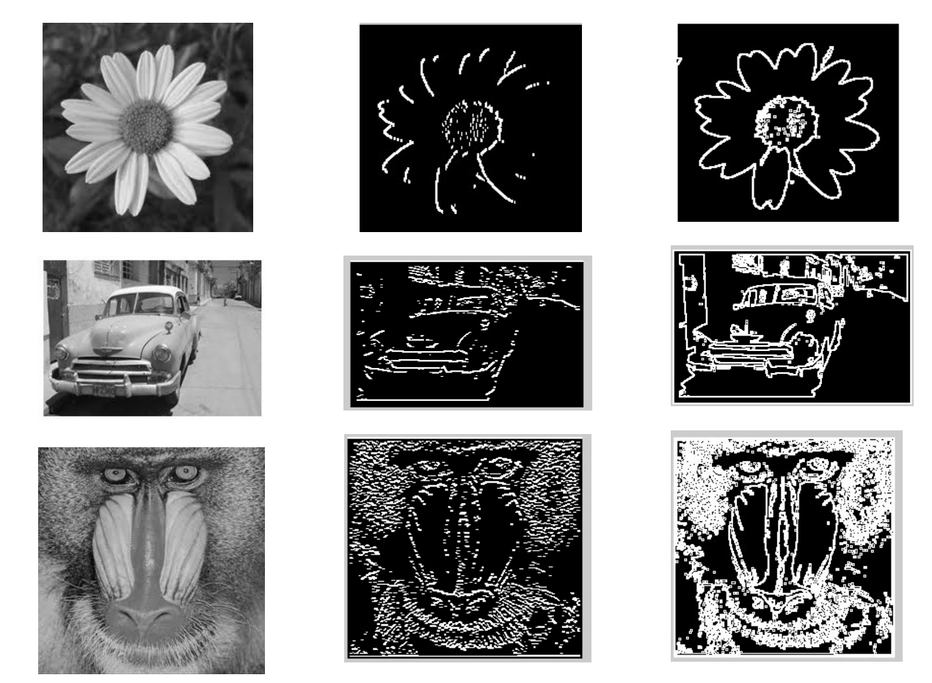
Example : Edge Detection

Slide 21
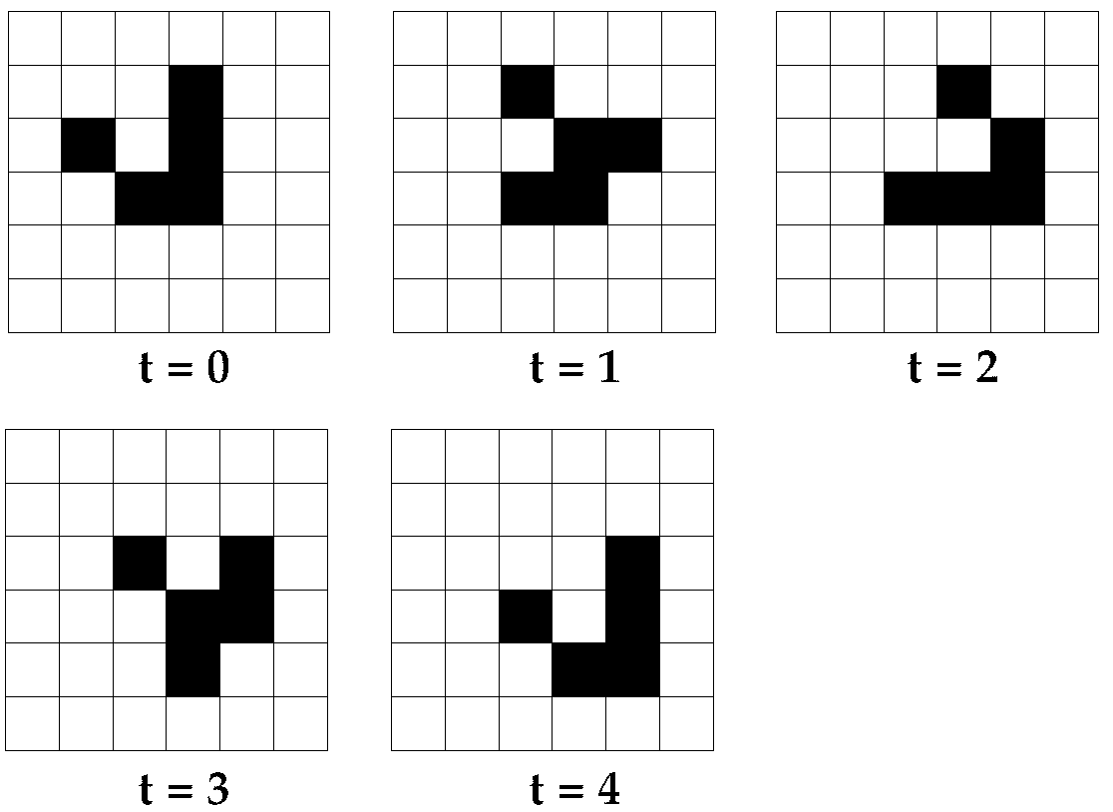
Game Of Life : Glider

Slide 22
Game Of Life
Movement/Animation based on logical rules :
Any live cell with two or three live neighbours survives.
Any dead cell with three live neighbours becomes a live cell.
All other live cells die in the next generation. Similarly, all other dead cells stay dead.

Slide 23
Game Of Life
0 | 0 | 0 | 0 | 0 | 0
0 | 0 | 0 | 1 | 0 | 0
0 | 1 | 0 | 1 | 0 | 0
0 | 0 | 1 | 1 | 0 | 0
0 | 0 | 0 | 0 | 0 | 0
0 | 0 | 0 | 0 | 0 | 0
Here we use “1” to represent LIVE, and “0” to represent DEAD

Slide 24
Computing t = 1
Previous State
New State
0 | 0 | 0 | 0 | 0 | 0
0 | 0 | 0 | 1 | 0 | 0
0 | 1 | 0 | 1 | 0 | 0
0 | 0 | 1 | 1 | 0 | 0
0 | 0 | 0 | 0 | 0 | 0
0 | 0 | 0 | 0 | 0 | 0
Cell[0]
Currently : DEAD
Number of LIVE neighbours : 0
Result : Stay DEAD (requires 3 LIVE neighbours to live)

Slide 25
Computing t = 1
Previous State
New State
0 | 0 | 0 | 0 | 0 | 0
0 | 0 | 0 | 1 | 0 | 0
0 | 1 | 0 | 1 | 0 | 0
0 | 0 | 1 | 1 | 0 | 0
0 | 0 | 0 | 0 | 0 | 0
0 | 0 | 0 | 0 | 0 | 0
0
Cell[1]
Currently : DEAD
Number of LIVE neighbours : 0
Result : Stay DEAD (requires 3 LIVE neighbours to live)

Slide 26
Computing t = 1
Previous State
New State
0 | 0 | 0 | 0 | 0 | 0
0 | 0 | 0 | 1 | 0 | 0
0 | 1 | 0 | 1 | 0 | 0
0 | 0 | 1 | 1 | 0 | 0
0 | 0 | 0 | 0 | 0 | 0
0 | 0 | 0 | 0 | 0 | 0
0 | 0
Cell[2]
Currently : DEAD
Number of LIVE neighbours : 1
Result: Stay DEAD (requires 3 LIVE neighbours to live)

Slide 27
Computing t = 1
Previous State
New State
0 | 0 | 0 | 0 | 0 | 0
0 | 0 | 0 | 1 | 0 | 0
0 | 1 | 0 | 1 | 0 | 0
0 | 0 | 1 | 1 | 0 | 0
0 | 0 | 0 | 0 | 0 | 0
0 | 0 | 0 | 0 | 0 | 0
0 | 0 | 0
Cell[3]
Currently : DEAD
Number of LIVE neighbours : 1
Result: Stay DEAD (requires 3 LIVE neighbours to live)

Slide 28
Computing t = 1
Previous State
New State
0 | 0 | 0 | 0 | 0 | 0
0 | 0 | 0 | 1 | 0 | 0
0 | 1 | 0 | 1 | 0 | 0
0 | 0 | 1 | 1 | 0 | 0
0 | 0 | 0 | 0 | 0 | 0
0 | 0 | 0 | 0 | 0 | 0
0 | 0 | 0 | 0
Cell[4]
Currently : DEAD
Number of LIVE neighbours : 1
Result: Stay DEAD (requires 3 LIVE neighbours to live)

Slide 29
Computing t = 1
Previous State
New State
0 | 0 | 0 | 0 | 0 | 0
0 | 0 | 0 | 1 | 0 | 0
0 | 1 | 0 | 1 | 0 | 0
0 | 0 | 1 | 1 | 0 | 0
0 | 0 | 0 | 0 | 0 | 0
0 | 0 | 0 | 0 | 0 | 0
0 | 0 | 0 | 0 | 0
Cell[5]
Currently : DEAD
Number of LIVE neighbours : 0
Result: Stay DEAD (requires 3 LIVE neighbours to live)

Slide 30
Computing t = 1
Previous State
New State
0 | 0 | 0 | 0 | 0 | 0
0 | 0 | 0 | 1 | 0 | 0
0 | 1 | 0 | 1 | 0 | 0
0 | 0 | 1 | 1 | 0 | 0
0 | 0 | 0 | 0 | 0 | 0
0 | 0 | 0 | 0 | 0 | 0
0 | 0 | 0 | 0 | 0 | 0
Cell[6]
Currently : DEAD
Number of LIVE neighbours : 1
Result: Stay DEAD (requires 3 LIVE neighbours to live)

Slide 31
Computing t = 1
Previous State
New State
0 | 0 | 0 | 0 | 0 | 0
0 | 0 | 0 | 1 | 0 | 0
0 | 1 | 0 | 1 | 0 | 0
0 | 0 | 1 | 1 | 0 | 0
0 | 0 | 0 | 0 | 0 | 0
0 | 0 | 0 | 0 | 0 | 0
0 | 0 | 0 | 0 | 0 | 0
0
Cell[7]
Currently : DEAD
Number of LIVE neighbours : 1
Result: Stay DEAD (requires 3 LIVE neighbours to live)

Slide 32
Computing t = 1
Previous State
New State
0 | 0 | 0 | 0 | 0 | 0
0 | 0 | 0 | 1 | 0 | 0
0 | 1 | 0 | 1 | 0 | 0
0 | 0 | 1 | 1 | 0 | 0
0 | 0 | 0 | 0 | 0 | 0
0 | 0 | 0 | 0 | 0 | 0
0 | 0 | 0 | 0 | 0 | 0
0 | 0
Cell[8]
Currently : DEAD
Number of LIVE neighbours : 3
Result: Become Alive (requires 3 LIVE neighbours to live)

Slide 33
Computing t = 1
Previous State
New State
0 | 0 | 0 | 0 | 0 | 0
0 | 0 | 0 | 1 | 0 | 0
0 | 1 | 0 | 1 | 0 | 0
0 | 0 | 1 | 1 | 0 | 0
0 | 0 | 0 | 0 | 0 | 0
0 | 0 | 0 | 0 | 0 | 0
0 | 0 | 0 | 0 | 0 | 0
0 | 0 | 1
Cell[9]
Currently : LIVE
Number of LIVE neighbours : 1
Result: Become DEAD (requires 2 or 3 LIVE neighbours to live)

Slide 34
Computing t = 1
Previous State
New State
0 | 0 | 0 | 0 | 0 | 0
0 | 0 | 0 | 1 | 0 | 0
0 | 1 | 0 | 1 | 0 | 0
0 | 0 | 1 | 1 | 0 | 0
0 | 0 | 0 | 0 | 0 | 0
0 | 0 | 0 | 0 | 0 | 0
0 | 0 | 0 | 0 | 0 | 0
0 | 0 | 1 | 0
Cell[10]
Currently : DEAD
Number of LIVE neighbours : 2
Result: Stay DEAD (requires 3 LIVE neighbours to live)

Slide 35
Computing t = 1
Previous State
New State
0 | 0 | 0 | 0 | 0 | 0
0 | 0 | 0 | 1 | 0 | 0
0 | 1 | 0 | 1 | 0 | 0
0 | 0 | 1 | 1 | 0 | 0
0 | 0 | 0 | 0 | 0 | 0
0 | 0 | 0 | 0 | 0 | 0
0 | 0 | 0 | 0 | 0 | 0
0 | 0 | 1 | 0 | 0
Cell[11]
Currently : DEAD
Number of LIVE neighbours : 0
Result: Stay DEAD (requires 3 LIVE neighbours to live)

Slide 36
Computing t = 1
Previous State
New State
0 | 0 | 0 | 0 | 0 | 0
0 | 0 | 0 | 1 | 0 | 0
0 | 1 | 0 | 1 | 0 | 0
0 | 0 | 1 | 1 | 0 | 0
0 | 0 | 0 | 0 | 0 | 0
0 | 0 | 0 | 0 | 0 | 0
0 | 0 | 0 | 0 | 0 | 0
0 | 0 | 1 | 0 | 0 | 0
Cell[12]
Currently : DEAD
Number of LIVE neighbours : 1
Result: Stay DEAD (requires 3 LIVE neighbours to live)

Slide 37
Computing t = 1
Previous State
New State
0 | 0 | 0 | 0 | 0 | 0
0 | 0 | 0 | 1 | 0 | 0
0 | 1 | 0 | 1 | 0 | 0
0 | 0 | 1 | 1 | 0 | 0
0 | 0 | 0 | 0 | 0 | 0
0 | 0 | 0 | 0 | 0 | 0
0 | 0 | 0 | 0 | 0 | 0
0 | 0 | 1 | 0 | 0 | 0
0
Cell[13]
Currently : LIVE
Number of LIVE neighbours : 1
Result: Become DEAD (requires 2 or 3 LIVE neighbours to live)

Slide 38
Computing t = 1
Previous State
New State
0 | 0 | 0 | 0 | 0 | 0
0 | 0 | 0 | 1 | 0 | 0
0 | 1 | 0 | 1 | 0 | 0
0 | 0 | 1 | 1 | 0 | 0
0 | 0 | 0 | 0 | 0 | 0
0 | 0 | 0 | 0 | 0 | 0
0 | 0 | 0 | 0 | 0 | 0
0 | 0 | 1 | 0 | 0 | 0
0 | 0
Cell[14]
Currently : DEAD
Number of LIVE neighbours : 5
Result: Stay DEAD (requires 3 LIVE neighbours to live)

Slide 39
Computing t = 1
Previous State
New State
0 | 0 | 0 | 0 | 0 | 0
0 | 0 | 0 | 1 | 0 | 0
0 | 1 | 0 | 1 | 0 | 0
0 | 0 | 1 | 1 | 0 | 0
0 | 0 | 0 | 0 | 0 | 0
0 | 0 | 0 | 0 | 0 | 0
0 | 0 | 0 | 0 | 0 | 0
0 | 0 | 1 | 0 | 0 | 0
0 | 0 | 0
Cell[15]
Currently : LIVE
Number of LIVE neighbours : 3
Result: Stay LIVE (requires 2 or 3 LIVE neighbours to live)

Slide 40
Computing t = 1
Previous State
New State
0 | 0 | 0 | 0 | 0 | 0
0 | 0 | 0 | 1 | 0 | 0
0 | 1 | 0 | 1 | 0 | 0
0 | 0 | 1 | 1 | 0 | 0
0 | 0 | 0 | 0 | 0 | 0
0 | 0 | 0 | 0 | 0 | 0
0 | 0 | 0 | 0 | 0 | 0
0 | 0 | 1 | 0 | 0 | 0
0 | 0 | 0 | 1
Cell[16]
Currently : DEAD
Number of LIVE neighbours : 3
Result: Become LIVE (requires 3 LIVE neighbours to live)

Slide 41
Computing t = 1
Previous State
New State
0 | 0 | 0 | 0 | 0 | 0
0 | 0 | 0 | 1 | 0 | 0
0 | 1 | 0 | 1 | 0 | 0
0 | 0 | 1 | 1 | 0 | 0
0 | 0 | 0 | 0 | 0 | 0
0 | 0 | 0 | 0 | 0 | 0
0 | 0 | 0 | 0 | 0 | 0
0 | 0 | 1 | 0 | 0 | 0
0 | 0 | 0 | 1 | 1
Cell[17]
Currently : DEAD
Number of LIVE neighbours : 0
Result: Stay DEAD (requires 3 LIVE neighbours to live)

Slide 42
Computing t = 1
Previous State
New State
0 | 0 | 0 | 0 | 0 | 0
0 | 0 | 0 | 1 | 0 | 0
0 | 1 | 0 | 1 | 0 | 0
0 | 0 | 1 | 1 | 0 | 0
0 | 0 | 0 | 0 | 0 | 0
0 | 0 | 0 | 0 | 0 | 0
0 | 0 | 0 | 0 | 0 | 0
0 | 0 | 1 | 0 | 0 | 0
0 | 0 | 0 | 1 | 1 | 0
Cell[18]
Currently : DEAD
Number of LIVE neighbours : 1
Result: Stay DEAD (requires 3 LIVE neighbours to live)

Slide 43
Computing t = 1
Previous State
New State
0 | 0 | 0 | 0 | 0 | 0
0 | 0 | 0 | 1 | 0 | 0
0 | 1 | 0 | 1 | 0 | 0
0 | 0 | 1 | 1 | 0 | 0
0 | 0 | 0 | 0 | 0 | 0
0 | 0 | 0 | 0 | 0 | 0
0 | 0 | 0 | 0 | 0 | 0
0 | 0 | 1 | 0 | 0 | 0
0 | 0 | 0 | 1 | 1 | 0
0
Cell[19]
Currently : DEAD
Number of LIVE neighbours : 2
Result: Stay DEAD (requires 3 LIVE neighbours to live)

Slide 44
Computing t = 1
Previous State
New State
0 | 0 | 0 | 0 | 0 | 0
0 | 0 | 0 | 1 | 0 | 0
0 | 1 | 0 | 1 | 0 | 0
0 | 0 | 1 | 1 | 0 | 0
0 | 0 | 0 | 0 | 0 | 0
0 | 0 | 0 | 0 | 0 | 0
0 | 0 | 0 | 0 | 0 | 0
0 | 0 | 1 | 0 | 0 | 0
0 | 0 | 0 | 1 | 1 | 0
0 | 0
Cell[20]
Currently : LIVE
Number of LIVE neighbours : 3
Result: Stay LIVE (requires 2 or 3 LIVE neighbours to live)

Slide 45
Computing t = 1
Previous State
New State
0 | 0 | 0 | 0 | 0 | 0
0 | 0 | 0 | 1 | 0 | 0
0 | 1 | 0 | 1 | 0 | 0
0 | 0 | 1 | 1 | 0 | 0
0 | 0 | 0 | 0 | 0 | 0
0 | 0 | 0 | 0 | 0 | 0
0 | 0 | 0 | 0 | 0 | 0
0 | 0 | 1 | 0 | 0 | 0
0 | 0 | 0 | 1 | 1 | 0
0 | 0 | 1
Cell[21]
Currently : LIVE
Number of LIVE neighbours : 2
Result: Stay LIVE (requires 2 or 3 LIVE neighbours to live)

Slide 46
Computing t = 1
Previous State
New State
0 | 0 | 0 | 0 | 0 | 0
0 | 0 | 0 | 1 | 0 | 0
0 | 1 | 0 | 1 | 0 | 0
0 | 0 | 1 | 1 | 0 | 0
0 | 0 | 0 | 0 | 0 | 0
0 | 0 | 0 | 0 | 0 | 0
0 | 0 | 0 | 0 | 0 | 0
0 | 0 | 1 | 0 | 0 | 0
0 | 0 | 0 | 1 | 1 | 0
0 | 0 | 1 | 1
Cell[22]
Currently : DEAD
Number of LIVE neighbours : 2
Result: Stay DEAD (requires 3 LIVE neighbours to live)

Slide 47
Computing t = 1
Previous State
New State
0 | 0 | 0 | 0 | 0 | 0
0 | 0 | 0 | 1 | 0 | 0
0 | 1 | 0 | 1 | 0 | 0
0 | 0 | 1 | 1 | 0 | 0
0 | 0 | 0 | 0 | 0 | 0
0 | 0 | 0 | 0 | 0 | 0
0 | 0 | 0 | 0 | 0 | 0
0 | 0 | 1 | 0 | 0 | 0
0 | 0 | 0 | 1 | 1 | 0
0 | 0 | 1 | 1 | 0
Cell[23]
Currently : DEAD
Number of LIVE neighbours : 0
Result: Stay DEAD (requires 3 LIVE neighbours to live)

Slide 48
Computing t = 1
Previous State
New State
0 | 0 | 0 | 0 | 0 | 0
0 | 0 | 0 | 1 | 0 | 0
0 | 1 | 0 | 1 | 0 | 0
0 | 0 | 1 | 1 | 0 | 0
0 | 0 | 0 | 0 | 0 | 0
0 | 0 | 0 | 0 | 0 | 0
0 | 0 | 0 | 0 | 0 | 0
0 | 0 | 1 | 0 | 0 | 0
0 | 0 | 0 | 1 | 1 | 0
0 | 0 | 1 | 1 | 0 | 0
Cell[24]
Currently : DEAD
Number of LIVE neighbours : 0
Result: Stay DEAD (requires 3 LIVE neighbours to live)

Slide 49
Computing t = 1
Previous State
New State
0 | 0 | 0 | 0 | 0 | 0
0 | 0 | 0 | 1 | 0 | 0
0 | 1 | 0 | 1 | 0 | 0
0 | 0 | 1 | 1 | 0 | 0
0 | 0 | 0 | 0 | 0 | 0
0 | 0 | 0 | 0 | 0 | 0
0 | 0 | 0 | 0 | 0 | 0
0 | 0 | 1 | 0 | 0 | 0
0 | 0 | 0 | 1 | 1 | 0
0 | 0 | 1 | 1 | 0 | 0
0
Cell[25]
Currently : DEAD
Number of LIVE neighbours : 1
Result: Stay DEAD (requires 3 LIVE neighbours to live)

Slide 50
Computing t = 1
Previous State
New State
0 | 0 | 0 | 0 | 0 | 0
0 | 0 | 0 | 1 | 0 | 0
0 | 1 | 0 | 1 | 0 | 0
0 | 0 | 1 | 1 | 0 | 0
0 | 0 | 0 | 0 | 0 | 0
0 | 0 | 0 | 0 | 0 | 0
0 | 0 | 0 | 0 | 0 | 0
0 | 0 | 1 | 0 | 0 | 0
0 | 0 | 0 | 1 | 1 | 0
0 | 0 | 1 | 1 | 0 | 0
0 | 0
Cell[26]
Currently : DEAD
Number of LIVE neighbours : 2
Result: Stay DEAD (requires 3 LIVE neighbours to live)

Slide 51
Computing t = 1
Previous State
New State
0 | 0 | 0 | 0 | 0 | 0
0 | 0 | 0 | 1 | 0 | 0
0 | 1 | 0 | 1 | 0 | 0
0 | 0 | 1 | 1 | 0 | 0
0 | 0 | 0 | 0 | 0 | 0
0 | 0 | 0 | 0 | 0 | 0
0 | 0 | 0 | 0 | 0 | 0
0 | 0 | 1 | 0 | 0 | 0
0 | 0 | 0 | 1 | 1 | 0
0 | 0 | 1 | 1 | 0 | 0
0 | 0 | 0
Cell[27]
Currently : DEAD
Number of LIVE neighbours : 2
Result: Stay DEAD (requires 3 LIVE neighbours to live)

Slide 52
Computing t = 1
Previous State
New State
0 | 0 | 0 | 0 | 0 | 0
0 | 0 | 0 | 1 | 0 | 0
0 | 1 | 0 | 1 | 0 | 0
0 | 0 | 1 | 1 | 0 | 0
0 | 0 | 0 | 0 | 0 | 0
0 | 0 | 0 | 0 | 0 | 0
0 | 0 | 0 | 0 | 0 | 0
0 | 0 | 1 | 0 | 0 | 0
0 | 0 | 0 | 1 | 1 | 0
0 | 0 | 1 | 1 | 0 | 0
0 | 0 | 0 | 0
Cell[28]
Currently : DEAD
Number of LIVE neighbours : 1
Result: Stay DEAD (requires 3 LIVE neighbours to live)

Slide 53
Computing t = 1
Previous State
New State
0 | 0 | 0 | 0 | 0 | 0
0 | 0 | 0 | 1 | 0 | 0
0 | 1 | 0 | 1 | 0 | 0
0 | 0 | 1 | 1 | 0 | 0
0 | 0 | 0 | 0 | 0 | 0
0 | 0 | 0 | 0 | 0 | 0
0 | 0 | 0 | 0 | 0 | 0
0 | 0 | 1 | 0 | 0 | 0
0 | 0 | 0 | 1 | 1 | 0
0 | 0 | 1 | 1 | 0 | 0
0 | 0 | 0 | 0 | 0
Cell[29]
Currently : DEAD
Number of LIVE neighbours : 0
Result: Stay DEAD (requires 3 LIVE neighbours to live)

Slide 54
Computing t = 1
Previous State
New State
0 | 0 | 0 | 0 | 0 | 0
0 | 0 | 0 | 1 | 0 | 0
0 | 1 | 0 | 1 | 0 | 0
0 | 0 | 1 | 1 | 0 | 0
0 | 0 | 0 | 0 | 0 | 0
0 | 0 | 0 | 0 | 0 | 0
0 | 0 | 0 | 0 | 0 | 0
0 | 0 | 1 | 0 | 0 | 0
0 | 0 | 0 | 1 | 1 | 0
0 | 0 | 1 | 1 | 0 | 0
0 | 0 | 0 | 0 | 0 | 0
Cell[30]
Currently : DEAD
Number of LIVE neighbours : 0
Result: Stay DEAD (requires 3 LIVE neighbours to live)

Slide 55
Computing t = 1
Previous State
New State
0 | 0 | 0 | 0 | 0 | 0
0 | 0 | 0 | 1 | 0 | 0
0 | 1 | 0 | 1 | 0 | 0
0 | 0 | 1 | 1 | 0 | 0
0 | 0 | 0 | 0 | 0 | 0
0 | 0 | 0 | 0 | 0 | 0
0 | 0 | 0 | 0 | 0 | 0
0 | 0 | 1 | 0 | 0 | 0
0 | 0 | 0 | 1 | 1 | 0
0 | 0 | 1 | 1 | 0 | 0
0 | 0 | 0 | 0 | 0 | 0
0
Cell[31]
Currently : DEAD
Number of LIVE neighbours : 0
Result: Stay DEAD (requires 3 LIVE neighbours to live)

Slide 56
Computing t = 1
Previous State
New State
0 | 0 | 0 | 0 | 0 | 0
0 | 0 | 0 | 1 | 0 | 0
0 | 1 | 0 | 1 | 0 | 0
0 | 0 | 1 | 1 | 0 | 0
0 | 0 | 0 | 0 | 0 | 0
0 | 0 | 0 | 0 | 0 | 0
0 | 0 | 0 | 0 | 0 | 0
0 | 0 | 1 | 0 | 0 | 0
0 | 0 | 0 | 1 | 1 | 0
0 | 0 | 1 | 1 | 0 | 0
0 | 0 | 0 | 0 | 0 | 0
0 | 0
Cell[32]
Currently : DEAD
Number of LIVE neighbours : 0
Result: Stay DEAD (requires 3 LIVE neighbours to live)

Slide 57
Computing t = 1
Previous State
New State
0 | 0 | 0 | 0 | 0 | 0
0 | 0 | 0 | 1 | 0 | 0
0 | 1 | 0 | 1 | 0 | 0
0 | 0 | 1 | 1 | 0 | 0
0 | 0 | 0 | 0 | 0 | 0
0 | 0 | 0 | 0 | 0 | 0
0 | 0 | 0 | 0 | 0 | 0
0 | 0 | 1 | 0 | 0 | 0
0 | 0 | 0 | 1 | 1 | 0
0 | 0 | 1 | 1 | 0 | 0
0 | 0 | 0 | 0 | 0 | 0
0 | 0 | 0
Cell[33]
Currently : DEAD
Number of LIVE neighbours : 0
Result: Stay DEAD (requires 3 LIVE neighbours to live)

Slide 58
Computing t = 1
Previous State
New State
0 | 0 | 0 | 0 | 0 | 0
0 | 0 | 0 | 1 | 0 | 0
0 | 1 | 0 | 1 | 0 | 0
0 | 0 | 1 | 1 | 0 | 0
0 | 0 | 0 | 0 | 0 | 0
0 | 0 | 0 | 0 | 0 | 0
0 | 0 | 0 | 0 | 0 | 0
0 | 0 | 1 | 0 | 0 | 0
0 | 0 | 0 | 1 | 1 | 0
0 | 0 | 1 | 1 | 0 | 0
0 | 0 | 0 | 0 | 0 | 0
0 | 0 | 0 | 0
Cell[34]
Currently : DEAD
Number of LIVE neighbours : 0
Result: Stay DEAD (requires 3 LIVE neighbours to live)

Slide 59
Computing t = 1
Previous State
New State
0 | 0 | 0 | 0 | 0 | 0
0 | 0 | 0 | 1 | 0 | 0
0 | 1 | 0 | 1 | 0 | 0
0 | 0 | 1 | 1 | 0 | 0
0 | 0 | 0 | 0 | 0 | 0
0 | 0 | 0 | 0 | 0 | 0
0 | 0 | 0 | 0 | 0 | 0
0 | 0 | 1 | 0 | 0 | 0
0 | 0 | 0 | 1 | 1 | 0
0 | 0 | 1 | 1 | 0 | 0
0 | 0 | 0 | 0 | 0 | 0
0 | 0 | 0 | 0 | 0
Cell[35]
Currently : DEAD
Number of LIVE neighbours : 0
Result: Stay DEAD (requires 3 LIVE neighbours to live)

Slide 60
Computing t = 1
Previous State
New State
0 | 0 | 0 | 0 | 0 | 0
0 | 0 | 0 | 1 | 0 | 0
0 | 1 | 0 | 1 | 0 | 0
0 | 0 | 1 | 1 | 0 | 0
0 | 0 | 0 | 0 | 0 | 0
0 | 0 | 0 | 0 | 0 | 0
0 | 0 | 0 | 0 | 0 | 0
0 | 0 | 1 | 0 | 0 | 0
0 | 0 | 0 | 1 | 1 | 0
0 | 0 | 1 | 1 | 0 | 0
0 | 0 | 0 | 0 | 0 | 0
0 | 0 | 0 | 0 | 0 | 0
DONE!!!!!

Slide 61

Good thing we know how to write code with loops :D

Slide 62
Going between worlds
In Game Of Life, need to be able to toggle cells DEAD and LIVE upon clicking on the cell
This means we need to deduce which grid cell we are clicking on based on the mouse position.

Slide 63
Screen and Mouse world
Positions based on the resolution of the screen
Seemingly continuous
But recall, ultimately it’s a grid

Slide 64
Mapping
0
X
0 | 0 | 0 | 0 | 0 | 0
0 | 0 | 1 | 0 | 0 | 0
0 | 0 | 0 | 1 | 1 | 0
0 | 0 | 1 | 1 | 0 | 0
0 | 0 | 0 | 0 | 0 | 0
0 | 0 | 0 | 0 | 0 | 0
Y

Slide 65
Mapping
The grid requires description:
Resolution of the grid, number of rows and columns of cells
Grid position, a single point that represents the entire grid
Grid extents, width and height of grid
int rows, columns;
CP_Vector grid_position;
CP_Vector grid_extents;

Slide 66
Mapping
0
X
0 | 0 | 0 | 0 | 0 | 0
0 | 0 | 1 | 0 | 0 | 0
0 | 0 | 0 | 1 | 1 | 0
0 | 0 | 1 | 1 | 0 | 0
0 | 0 | 0 | 0 | 0 | 0
0 | 0 | 0 | 0 | 0 | 0
Grid position
Grid extents
Y

Slide 67
Getting grid cell from mouse position
First compute mouse position relative to grid position
Relative_position = mouse_position – grid_position

Slide 68
Effect
0
X
0 | 0 | 0 | 0 | 0 | 0
0 | 0 | 1 | 0 | 0 | 0
0 | 0 | 0 | 1 | 1 | 0
0 | 0 | 1 | 1 | 0 | 0
0 | 0 | 0 | 0 | 0 | 0
0 | 0 | 0 | 0 | 0 | 0
Y

Slide 69
Getting grid cell from mouse position
Second, check if mouse_position is within the grid_extents
If (0 <= mouse_position <= grid_extents)
Do note that this is not proper C syntax and we cannot compare vectors in such a way
We continue to the next step if mouse_position is within grid_extents

Slide 70
Getting grid cell from mouse position
Finally, we just need to determine the cell being clicked on
The cell can be defined by its row and column position on the grid
cell_row = mouse_position.y / cell_height
cell_column = mouse_position.x / cell_width
Where do cell_height and cell_width come from?

